Slide 1
CSEM Building block LNOI
Jacopo Leo
Homa Zarebidaki

Slide 2
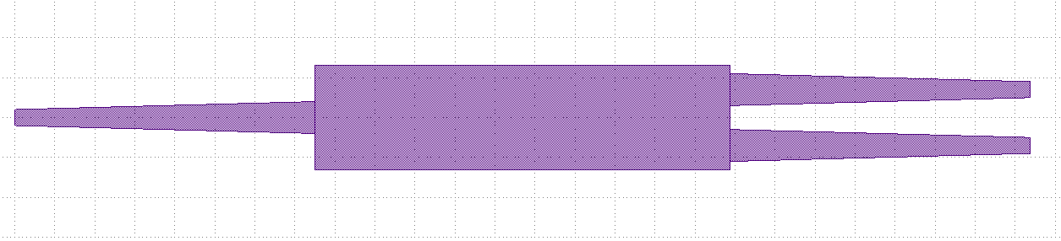
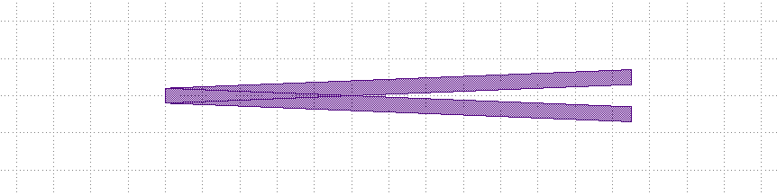
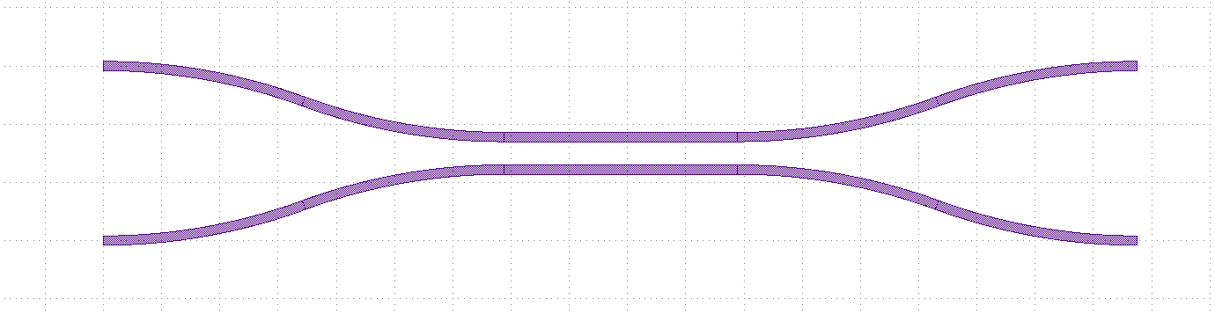
Coupler 1x2
Multi mode interferometer (MMI)
Y-junction
Directional coupler

Slide 3
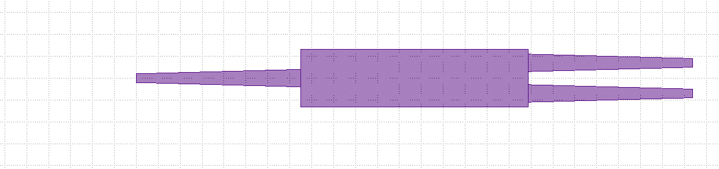
MMI
Parameters:
  waveguide_width
  length
  width
  width_tapper
  length_tapper
  gap
length
length_tapper
a0
Waveguide_width
width_tapper
width
gap
b1
b0

Slide 4
Y-junction
length
Parameters:
  waveguide_width
  length
  gap
b1
Waveguide_width
gap
a0
b0

Slide 5
Directional coupler
a1
b1
Parameters:
  waveguide_width
  length
  gap
  spacing
  bend_type: euler or s-bend
  Extra:
    max_angle: 90
length
gap
spacing
Waveguide_width
a0
bend_type with max_angle
b0

Slide 6
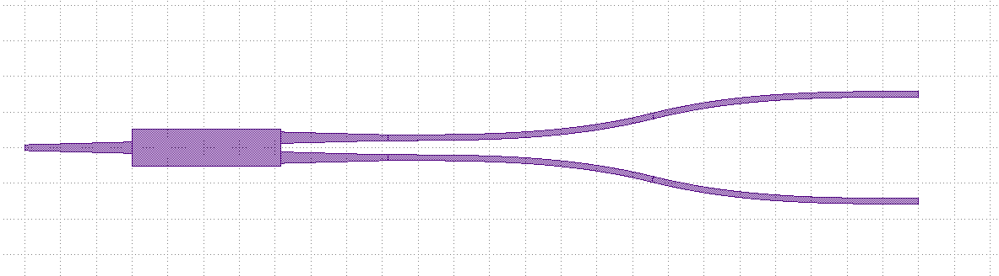
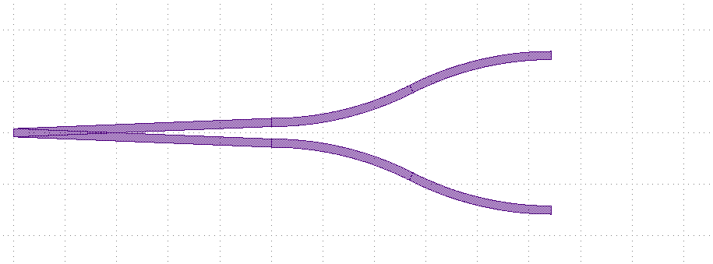
Extra-parameters for Coupler MMI/Y-Junction
Parameters:
  spacing
  bend_type: euler or s-bend
  max_angle: max angle of bend
bend_type with max_angle
b1
a0
spacing
b0
MMI extra-parameters
bend_type with max_angle
b1
a0
spacing
b0
Y-Junction extra-parameters

Slide 7
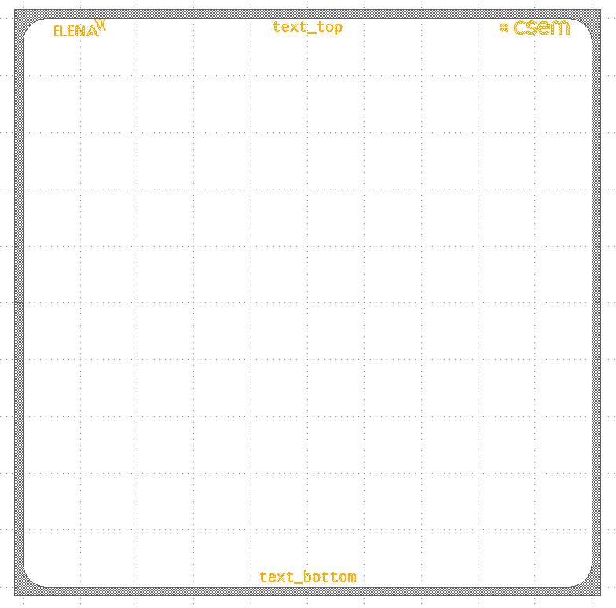
Border chip
Parameters:
  Extra:
    chip_size_x : 5000
    chip_size_y : 5000
    extra_size: 150
    radius: 200
radius
Text top
extra_size
chip_size_y
chip_size_x
Text bottop

Slide 8
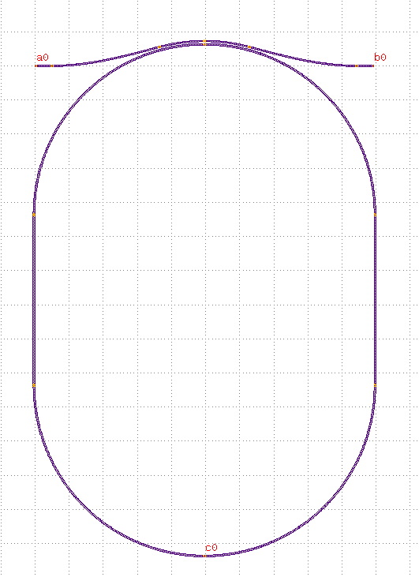
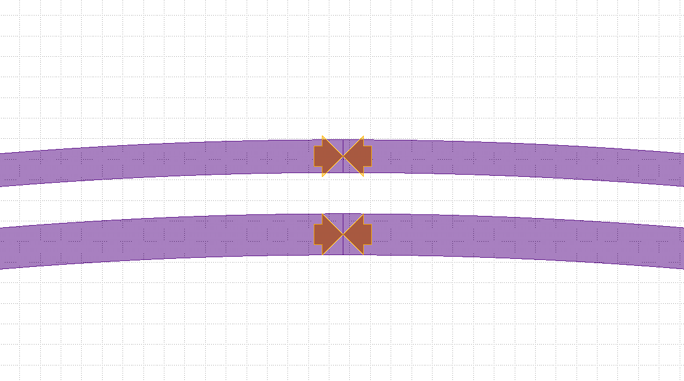
Resonator
bus_wg_width
b0
a0
Parameters:
  bus_waveguide_width
  resonator_waveguide_width
  radius
  Extra:
    length_straight: 0 um
    angle: 0 degree
    bend: euler or s-bend
gap
resonator_wg_width
Length_straight
radius

Slide 9
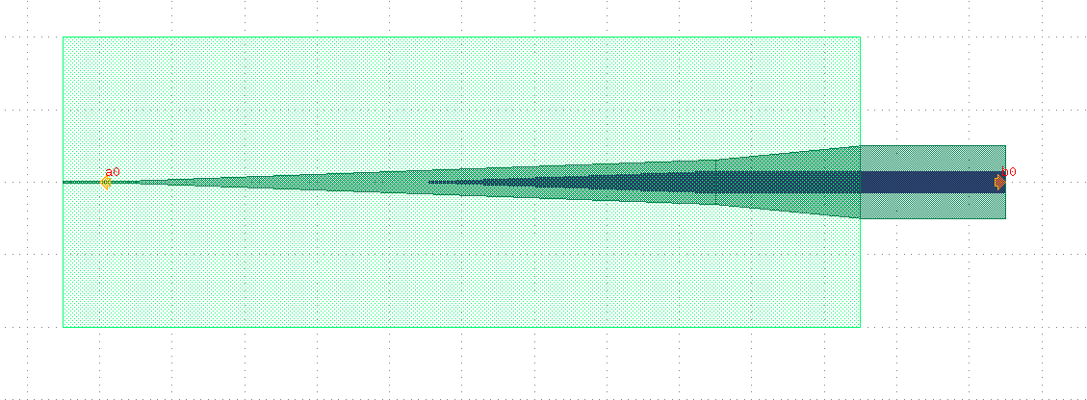
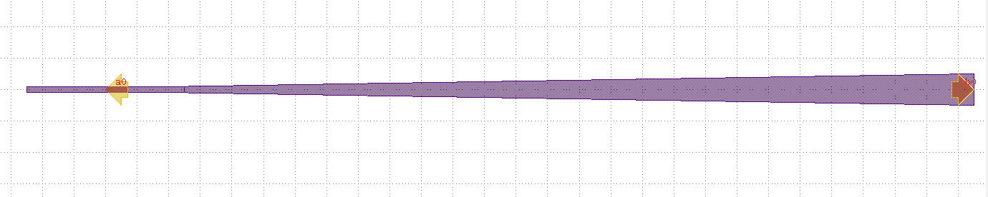
Edge coupler
Single Edge coupler
Double Edge coupler

Slide 10
Single Edge coupler
Parameters:
  waveguide_width
  length
  width
  Extra:
    length_front_extend: 5 um
waveguide_width
a0
width
Length_front_extend
length
b0

Slide 11
Double Edge coupler
window_open
Parameters:
  wavegudie_width
  width1
  width2
  width3
  width_top_tapper
  length1
  length2
  length3
  Extra:
    length_front_extend: 5 um
    length_back_extend: 10 um
    window_open: 50 um
width3
width1
  width_top_tapper
width2
b0
a0
length_front_extend
length1
length2
waveguide_width
length3
Length_back_extend

Slide 12
Notes:
Contact slide

